Slide 1
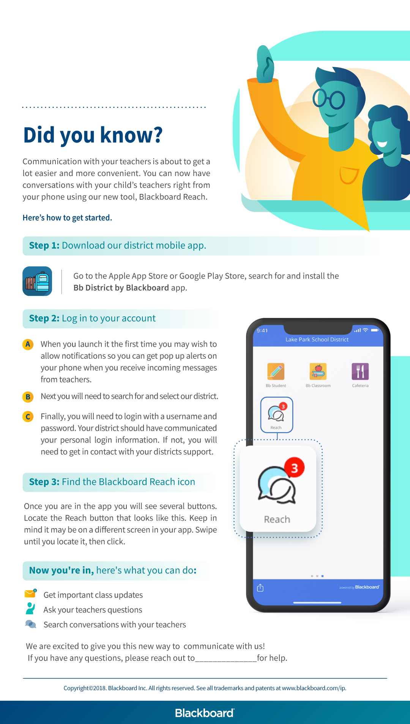
Add district or school logo here
Add contact here

